Slide 1
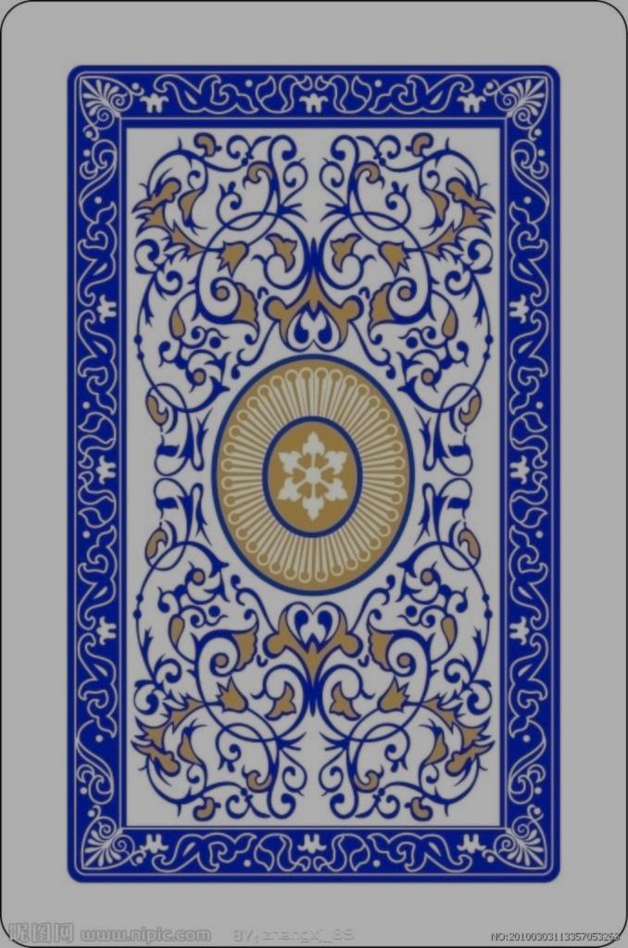

Slide 3
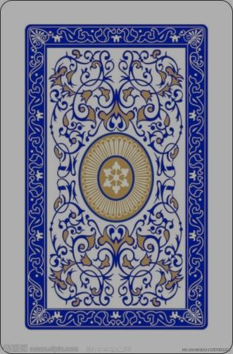
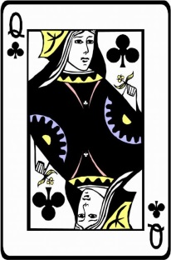

Slide 4
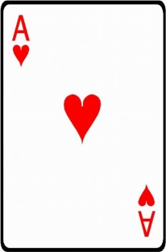

Slide 5
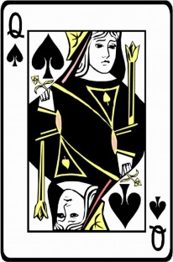
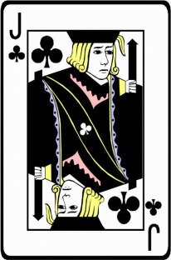
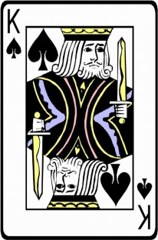
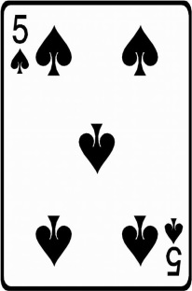
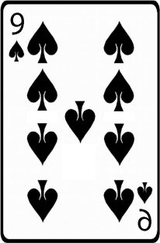
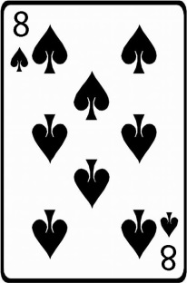
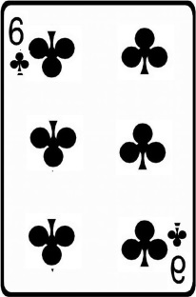
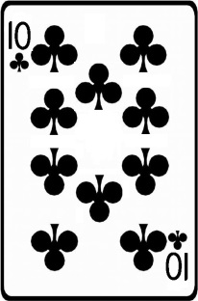
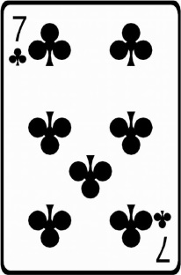

Slide 6
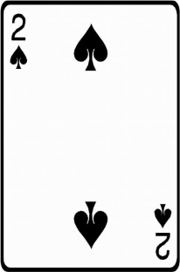
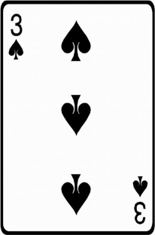
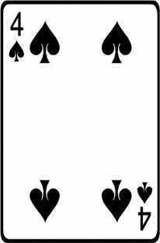
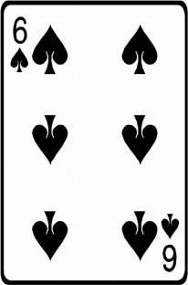
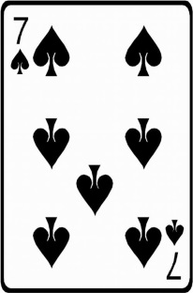
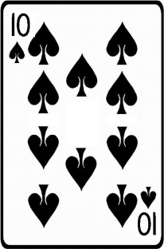
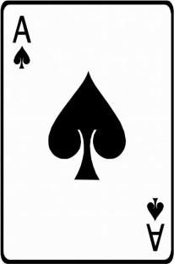
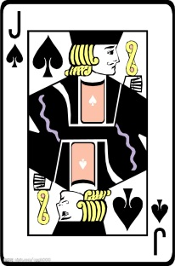
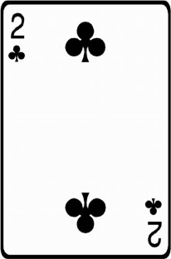
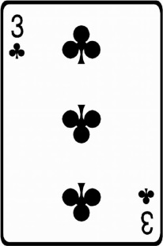
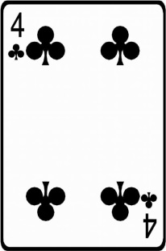
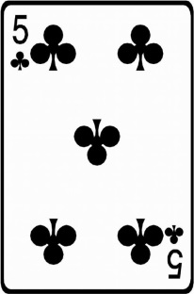
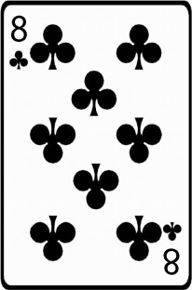
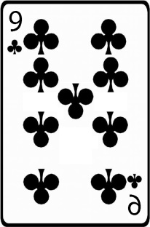
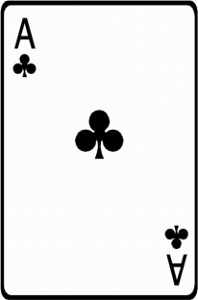
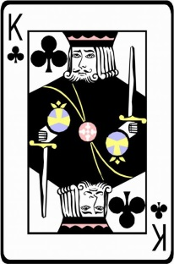

Slide 7
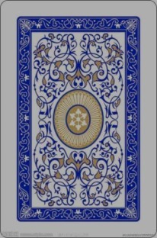
5
+

Slide 8




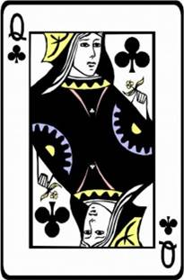

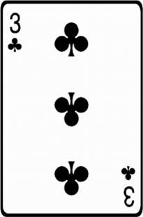



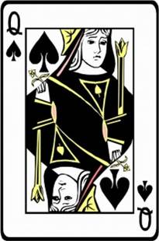
You Win!
+5
+
Notes:
W70S4-2

Slide 9
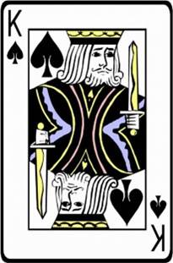



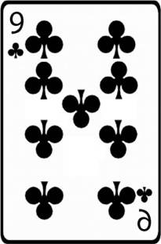
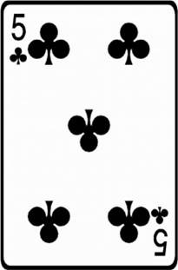
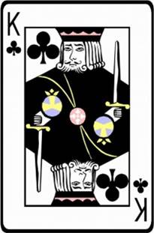
You Win!
+5
+
Notes:
W70S5-3

Slide 10

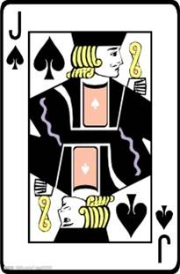
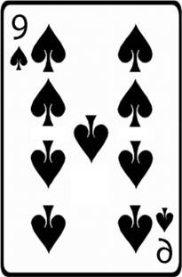
You Win!
+5
+
Notes:
W70S6-4

Slide 11

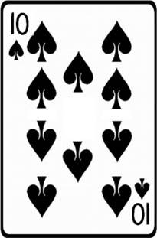
You Win!
+5
+
Notes:
W70S7-2

Slide 12


You Win!
+5
+
Notes:
W70S8-3

Slide 13

You Win!
+5
+
Notes:
W70S9-1

Slide 14

You Win!
+5
+
Notes:
W70S11-6

Slide 15
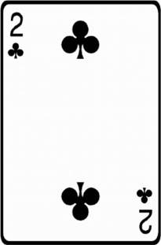
You Win!
+5
+
Notes:
W70S12-5

Slide 16
You Win!
+5
+
Notes:
W70S13-2

Slide 17
You Win!
+5
+
Notes:
W70S14-7

Slide 18
You Win!
+5
+
Notes:
W70S15-4

Slide 19
You Win!
+5
+
Notes:
W70S16-7

Slide 20
You Win!
+5
+
Notes:
W70S17-4

Slide 21
You Win!
+5
+
Notes:
W70S18-6

Slide 22
You Win!
+5
+
Notes:
W70S19-2

Slide 23
You Win!
+5
+
Notes:
W70S20-5

Slide 24
You Win!
+5
+
Notes:
W70S21-6

Slide 25
You Win!
+5
+
Notes:
W70S22-2

Slide 26
You Win!
+5
+
Notes:
W70S23-5

Slide 27
You Win!
+5
+
Notes:
W70S24-5

Slide 28
You Win!
+5
+
Notes:
W70S25-4

Slide 29
You Win!
+5
+
Notes:
W70S26-7

Slide 30
You Win!
+5
+
Notes:
W70S27-7

Slide 31
You Win!
+5
+
Notes:
W70S28-2

Slide 32
You Win!
+5
+
Notes:
W70S29-1

Slide 33
You Win!
+5
+
Notes:
W70S30-3

Slide 34
You Win!
+5
+
Notes:
W70S31-3

Slide 35
You Win!
+5
+
Notes:
W70S32-3

Slide 36
You Win!
+5
+
Notes:
W70S33-4

Slide 37
You Win!
+5
+
Notes:
W70S34-2

Slide 38
You Win!
+5
+
Notes:
W70S35-5

Slide 39

You Lose!
-5
+

Slide 40
25
+

Slide 41

25
You Win!
+25
+

Slide 42

25
You Lose!
-25
+

